Slide 1
Lazy Prices
A persistent arbitrage opportunity

Slide 2

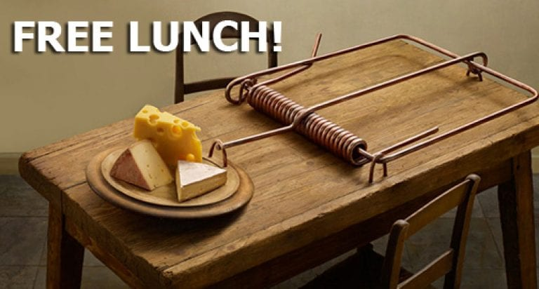

Slide 3


Slide 4
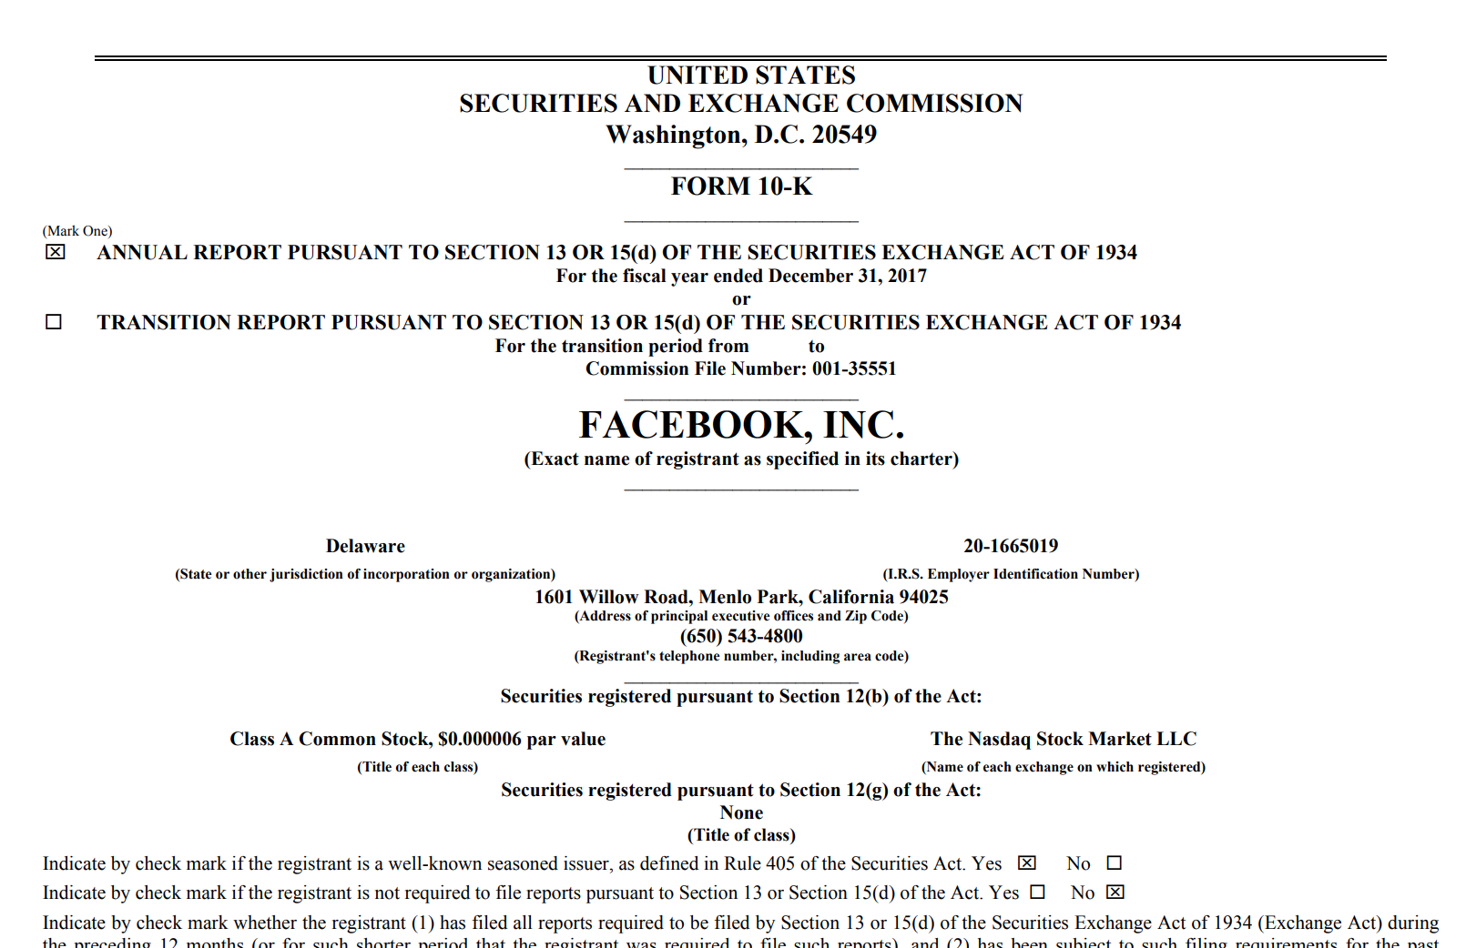
10K Report from SEC Edgar DB

Slide 5
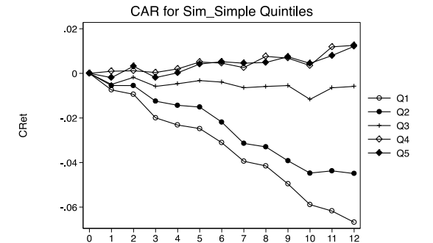

Slide 6
Free Lunch?

Slide 7
S&P 500 Case Study
S&P 500 is the watched and analyzed American stock index
If Lazy Prices are true for the S&P it would follow that it is possibly true for the market in general

Slide 8
Methodology
Scraped 10 K reports from SEC Edgar
Parsed file to remove numerical tables and HTML tags
Created measure of year on year score based on Jaccard Similarity.
Obtained the daily close prices for the S&P 500 Components for the past 5 years
Transformed the data to the 8 month percentage change in the stock price from the start of the year

Slide 9
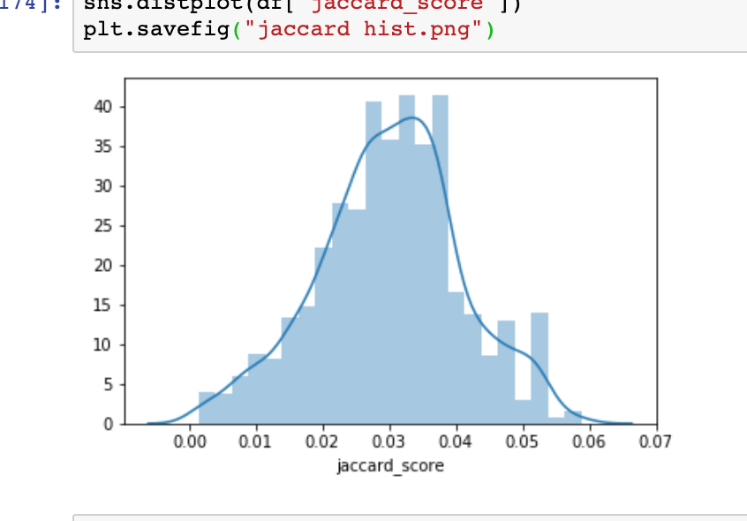
Exploratory Data Analysis

Slide 10
Hypothesis 1: Companies with significant 10-k changes underperform the market
H₀ : Δ price_{10k change} = Δ price_{sp500}
H_{A}: Δ price_{10k change} > Δ price_{sp500}
Hypothesis 2: The Lazy prices effect persists in 2019
H₀ : Mean Price_{10k change in 2018} = Mean Price_{10k change in 2019}
H_{A}: Mean Price_{10k change in 2018} ≠ Mean Price_{10k change in 2019}
Hypothesis 3: Lazy price effect is continuous
H₀ : effect smaller change = Effect Larger Change
H_{A}: effect smaller change ≠ Effect Larger Change

Slide 11
Hypothesis 1: The average return will be different depending on how varied the 10k report is from the previous year
H₀ : Δ price_{10k change} = Δ price_{sp500}
H_{A}: Δ price_{10k change} < Δ price_{sp500}
P-Value = 8.191741499293817e-12

Slide 12
Hypothesis 2: The Lazy prices effect persists in 2019
H₀ : Mean Price_{10k change in 2018} = Mean Price_{10k change in 2019}
H_{A}: Mean Price_{10k change in 2018} ≠ Mean Price_{10k change in 2019}
statistic=-0.598651901429536, pvalue=0.553240269431968

Slide 13
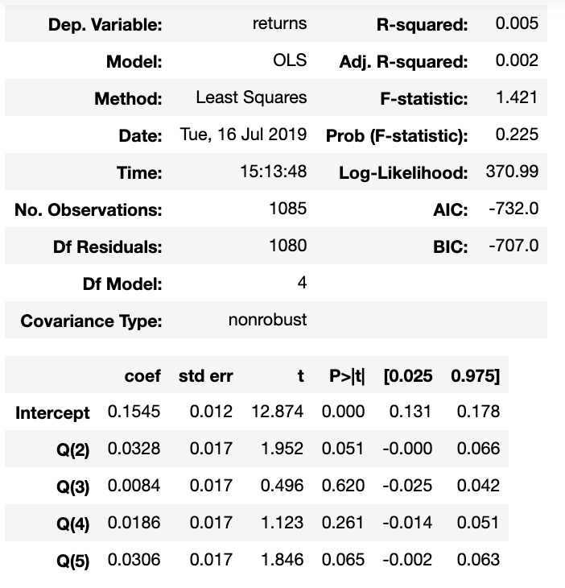
Hypothesis 3: Hypothesis 3: Lazy price effect is continuous
H₀: Q₁ = Q₂ = Q₃ = Q₄ = Q₅
H₁: Q₁ <Q₂ < Q₃ <Q₄ < Q₅

